Slide 1
Day 4 – Planning and Estimation in Scrum

Slide 2
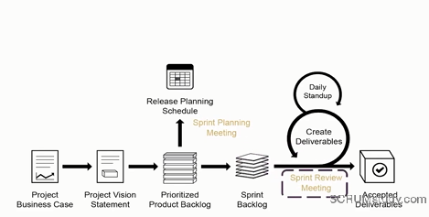
SCRUM Process - Review

Slide 3
Estimating User Stories

Slide 4
State of the nation …
Agile development techniques are popular
Agile methods are characterized by incremental delivery and frequent course correction
What we want ….
An ORACLE
How long will my software take to build and when will it get done?
Simple way to do it ..
What we have
Complicated mathematical formula’s
Estimation methods learning which can qualify you for a PhD

Slide 5
Planning Poker
What if you could answer the question
“How long will my software take to build and when will it get done?” by playing a game of cards?

Slide 6
Planning Poker
Planning poker is attributed to Grenning and is a fairly recent development (2002)
Planning poker combines expert opinion, analogy, and disaggregation into an enjoyable approach to estimating that results in quick but reliable estimates
Participants in planning poker include all of the developers on the team

Slide 7
Planning Poker
At the start of planning poker, each estimator is given a deck of cards. Each card has written on it one of the valid estimates 0, ½, 1, 2, 3, 5, 8, 13, 20, 40, and 100
You may also use a ? And {coffee} card

Slide 8
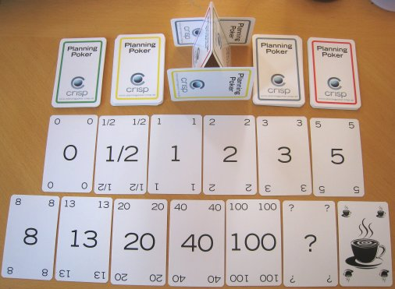

Slide 9
Planning Poker – The Rules of the Game
Someone (typically the PM) plays the moderator
For each user story or theme to be estimated, a moderator reads the description
The product owner answers any questions that the estimators have
After all questions are answered, each estimator privately selects a card representing his or her estimate

Slide 10
Planning Poker – The Rules of the Game
Cards are not shown until each estimator has made a selection
At that time, all cards are simultaneously turned over and shown so that all participants can see each estimate.
It is very likely at this point that the estimates will differ significantly.
If estimates differ, the high and low estimators explain their estimates
Repeat until the estimators have reached a lose consensus
The consensus number is size estimate

Slide 11
Planning Poker – Using the results
Story / Feature | Estimate
X | 5
Y | 8
Z | 2
The team will decide how much work they can achieve in the given iteration based on estimates, for example, from the estimates above the team decides they can finish the story “X” in the one week iteration

Slide 12
Planning Poker – Using the results
After the iteration finishes if the team has successfully delivered the story “X”
we can assume that the team can deliver 5 size equivalent of work every week, this is called the “velocity” of the team
In other words, “velocity” is the amount of work the team has been delivering over a period of time

Slide 13
Why it works?
It brings together multiple expert opinions to do the estimating.
Kind of like “wisdom of crowds”
Improves the quality of estimation
estimators are called upon by their peers to justify their estimates
averaging individual estimates leads to better results

Slide 14
Why it works?
Fibonacci numbers – “golden ratio”
The unexplained, kind of like the “X – Files”
It works because it’s fun
Don’t things always work out well when you are having fun?

Slide 15
Planning Poker Exercise
Group into 4 Groups
Each Person Get a Pen and Paper
Write your estimate (1, 2, 3, 5, 8, 13, 20, 40)
Show To Each other when Everyone’s done writing an estimate
Discuss and agree on an estimate for each User Story

Slide 16
Planning Poker Exercise User Stories
As a DLSU Student, I can see my grades for the current semester online so that I don’t have to wait until I get to school to know whether I’m passing
As a DLSU Teacher, I can update grades online so I no longer depend on administrators to do that for me.

Slide 17
Planning your First Sprint

Slide 18
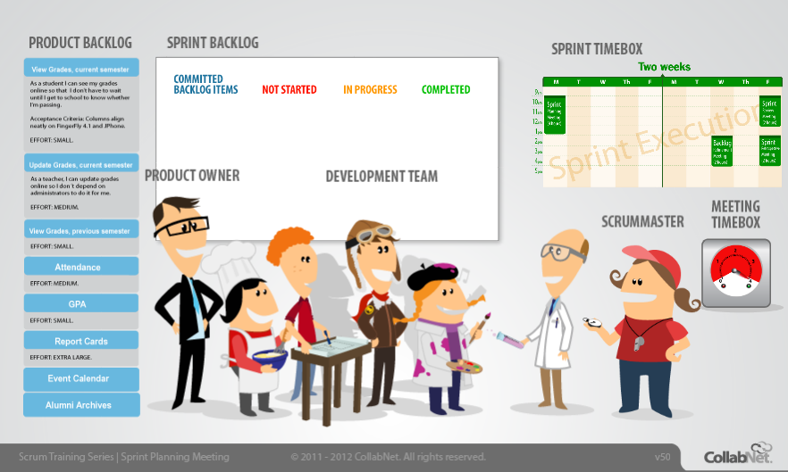
Sprint Planning Meeting
http://scrumtrainingseries.com/SprintPlanningMeeting/SprintPlanningMeeting.htm

Slide 19
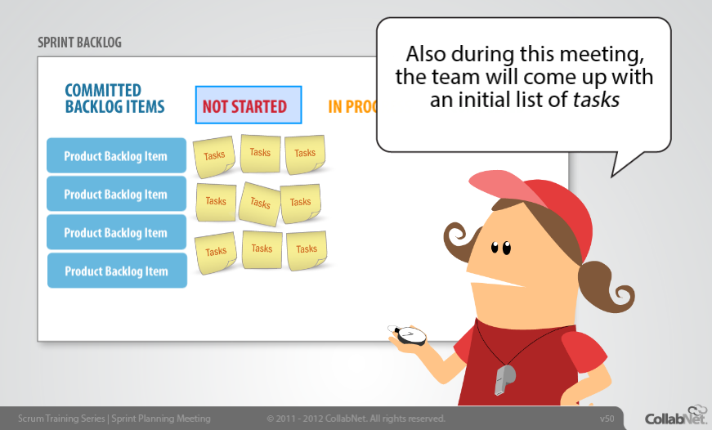
Sprint Planning Meeting
http://scrumtrainingseries.com/SprintPlanningMeeting/SprintPlanningMeeting.htm

Slide 20
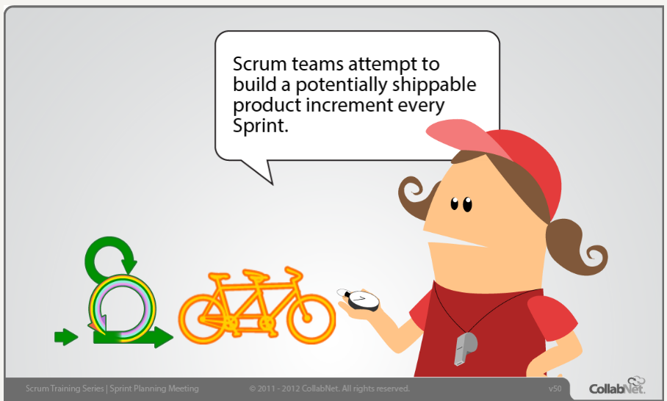
http://scrumtrainingseries.com/SprintPlanningMeeting/SprintPlanningMeeting.htm

Slide 21
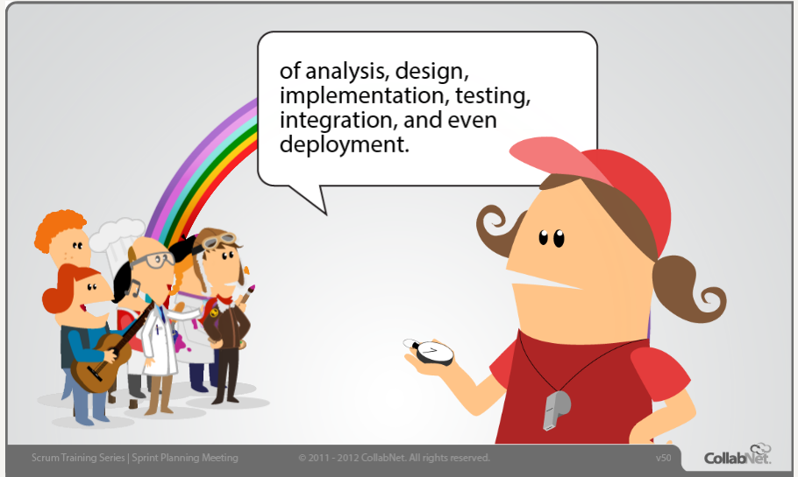
Every Sprint needs a mix
http://scrumtrainingseries.com/SprintPlanningMeeting/SprintPlanningMeeting.htm

Slide 22
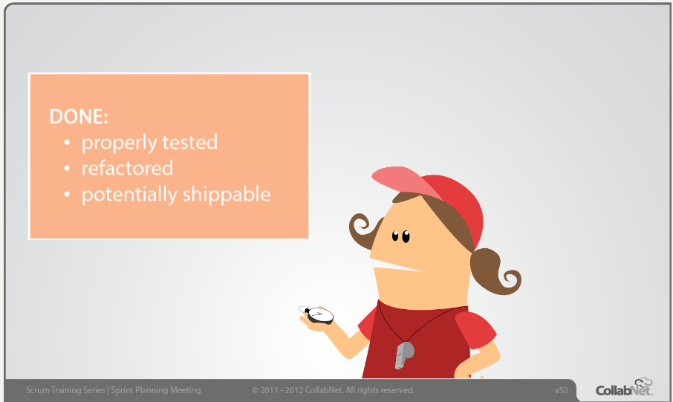
Definition of Done in a sprint
http://scrumtrainingseries.com/SprintPlanningMeeting/SprintPlanningMeeting.htm

Slide 23
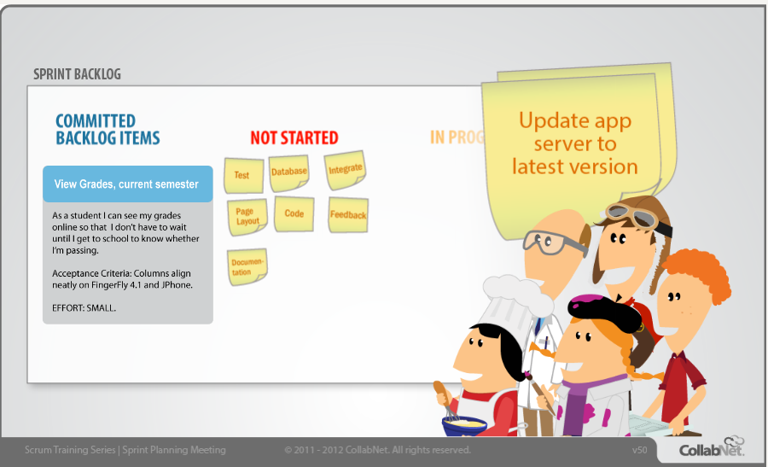
Adding Tasks
http://scrumtrainingseries.com/SprintPlanningMeeting/SprintPlanningMeeting.htm

Slide 24
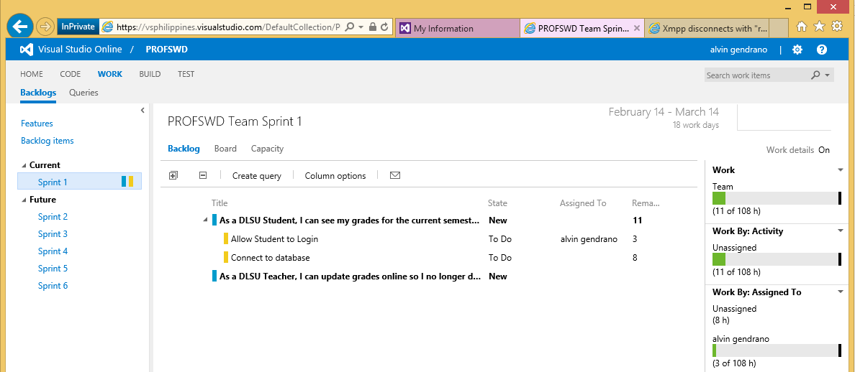
Demo: Putting it all together in Visual Studio Online

Slide 25
Next Week’s Deliverables (CO2)
In Visual Studio Online (www.visualstudio.com)
Product Backlog – User Stories
Guide: http://www.visualstudio.com/en-us/get-started/create-your-backlog-vs
Sprint 1 Plan (Feb 14 to Mar 14)
Guide: http://www.visualstudio.com/en-us/get-started/work-in-sprints-vs
Each Team will have 8 minutes to discuss their Product Backlog and Sprint 1 plans from Visual Studio Online
Make sure to add alving@outlook.ph to your Visual Studio online project teams.

